Slide 1
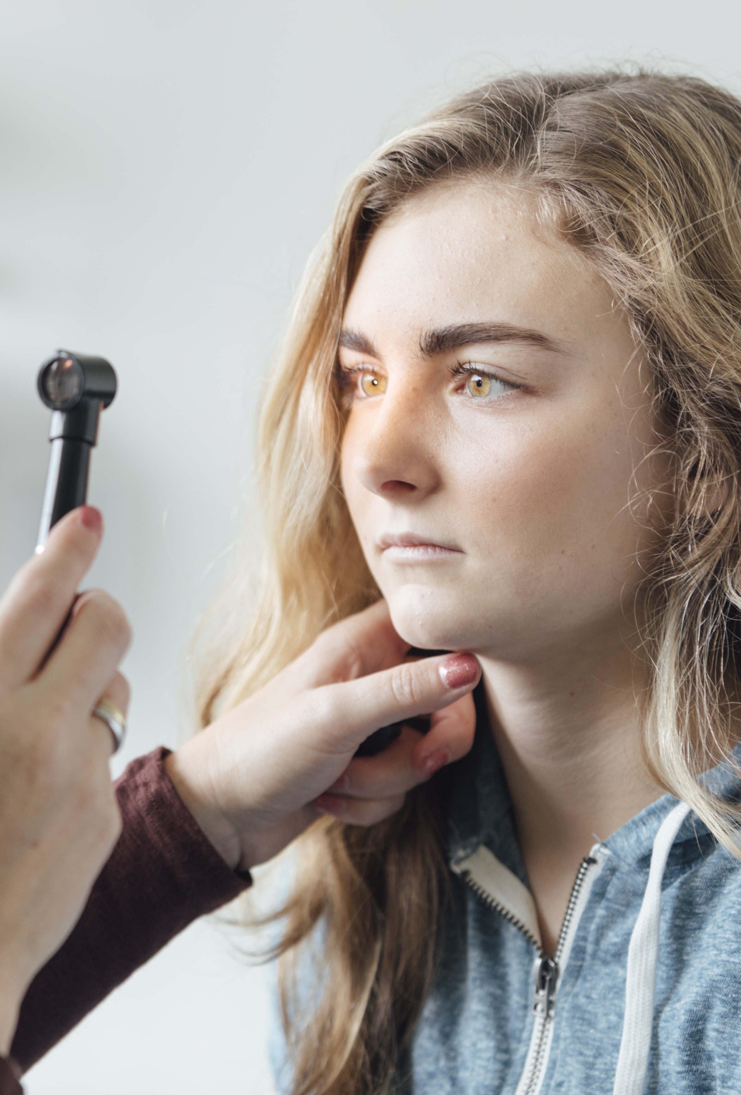
DRN Screening App – Early Detection to Prevent Vision Loss
Detecting Diabetic Retinal Neuropathy via Pupillometry & Gaze Tracking
Presented by: Tanmay Chadha | Henrychris Nwanaju - Group 07

Slide 2
Why This App? (The Personal Why)
“My mother has Type 2 Diabetes. This inspired me to address the silent onset of vision loss in diabetic patients.”
Type 2 diabetes affects millions — often silently damaging vision
DRN (Diabetic Retinal Neuropathy) comes before diabetic retinopathy
Current tools miss early-stage neural damage
We built this app to bridge this diagnostic gap — accessible, objective, and fast

Slide 3
Biomarkers We Analyse
Biomarker | What It Tells Us
PLR Latency (s) | Delay between flash and pupil reaction (neural response)
Constriction Amplitude | How much pupil shrinks — reflex strength
PIPR | Post-illumination reaction — autonomic recovery
Baseline Size | Normal pupil size before flash
Gaze SD (X/Y) | Gaze stability — precision of eye movement
BCEA | Elliptical gaze error area — attention focus measure
Saccades | Number of rapid eye shifts — cognitive response proxy
“Each of these tells us how the retina and neural pathways are functioning.”

Slide 4
Backend Flow – Overview
Test Initiated from Frontend (webcam.js)
Flask Route /run_test receives patient_name and flash_timestamp
Triggers run_capture() to:
Start webcam (OpenCV)
Present flash (1.5s delay)
Record 6 seconds of frames + timestamps
Video + stimulus time passed to process_video()
Biomarkers are calculated → Results + plots generated → Stored locally
📁 Also uses:
SQLite for storage
Matplotlib for plotting
fpdf for PDF summary
Backend: Python (Flask), OpenCV, MediaPipe, TensorFlow Lite

Slide 5
Gaze Tracking & Pupillometry (Core Analysis)
Uses MediaPipe FaceMesh:
Tracks ~470 facial landmarks
Iris (landmarks 474–477), eye contours (468–473)
Pupil Detection:
Radius calculated from iris points (Euclidean distance)
Baseline + post-flash values extracted
Gaze Detection:
Averages of eye movement landmarks → (x, y)
Calculated standard deviation, velocity, BCEA
Saccades:
Detected via velocity spikes in gaze data
💡 TensorFlow Lite & XNNPACK delegate used for real-time inference.
High-resolution gaze and pupil data from basic webcam using AI - Pretrained AI models from MediaPipe and TensorFlow Lite
To extract gaze, iris, and pupil biomarkers from video.

Slide 6
Result Generation & Storage
Raw data saved as CSV (pupil_size, gaze_x/y, timestamps)
Matplotlib generates:
📈 Pupil Response Plot
🎯 Gaze Stability Scatter
PDF Summary:
Biomarkers + Risk flags + Plots
Created with create_pdf_summary() (via fpdf)
Database entry saved in patients.db via save_results_to_db()
📌 All files linked per patient:
static/results/...csv / .png / .pdf

Slide 7
Backend Integration Recap – FILE STRUCTURE OVERVIEW
Frontend | Backend | Database & Storage
templates/login.html | app.py – Flask routing & logic | data/patients.db – SQLite DB
templates/dashboard.html | capture/video_capture.py – Webcam capture & stimulus sync | static/results/ – CSV, plots, PDF
templates/test.html | analysis/biomarker_analysis.py – Pupil & gaze processing
templates/results.html | stimulus/stimulus_presenter.py – Flash presentation logic
static/css/styles.css | utils/plot_utils.py – Generates plots
static/js/webcam.js | utils/pdf_utils.py – PDF summary generator
static/images/clinic_logo.jpg
Technologies Used:
🧠 Focus: All computation is local, fast, and works with just a webcam

Slide 8

Frontend Overview
User-friendly, responsive interface for clinicians
Built using:
HTML5
CSS3
JavaScript
Flask templating (Jinja2)
Key Screens:
Login page
Dashboard
Start Test with webcam & progress bar
Results page with:
Biomarker table
Risk indicators
Plots + PDF download

Slide 9
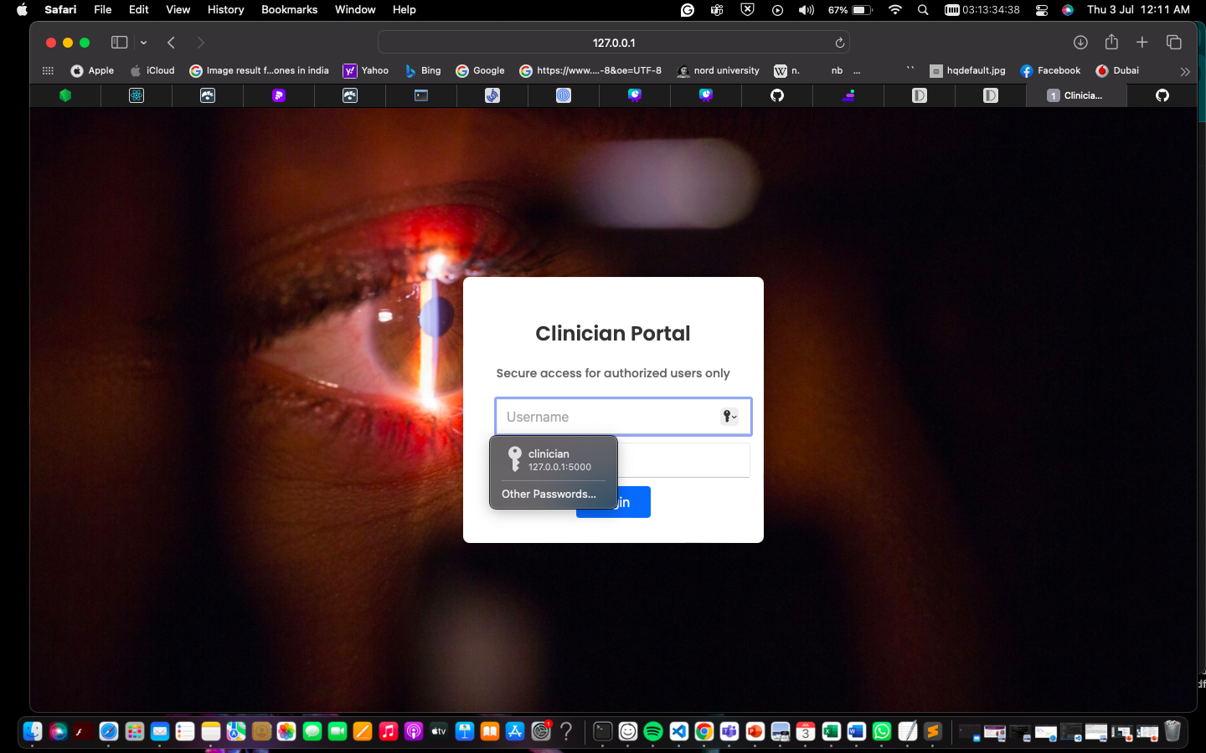
THE LOGIN PAGE - VIEW
The app's flow – The clinician starts by logging in. http://www.127.0.0.1:5000
FIGURE 1: SCREENSHOT OF LOGIN PAGE

Slide 10
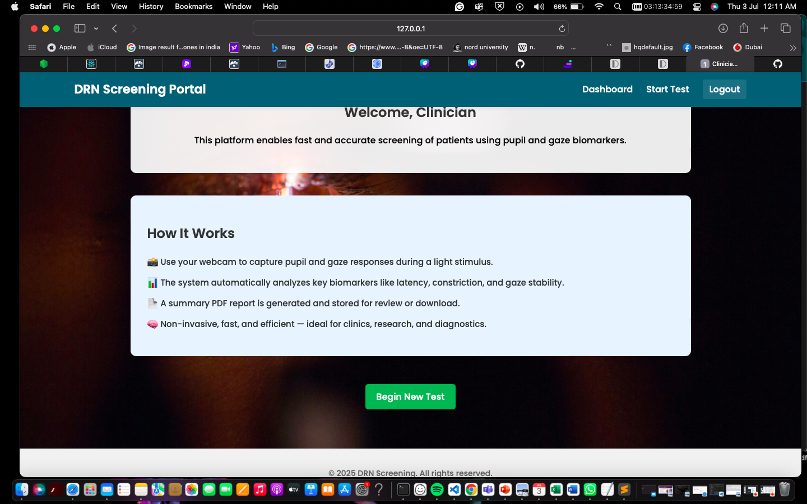
THE DASHBOARD PAGE - VIEW
FIGURE 2: SCREENSHOT OF DASHBOARD PAGE
The app's flow – The clinician is then directed to the dashboard page where they can overview the general information of the app, and from there they can click the “Begin new test” button, which directs them to the main test page.

Slide 11
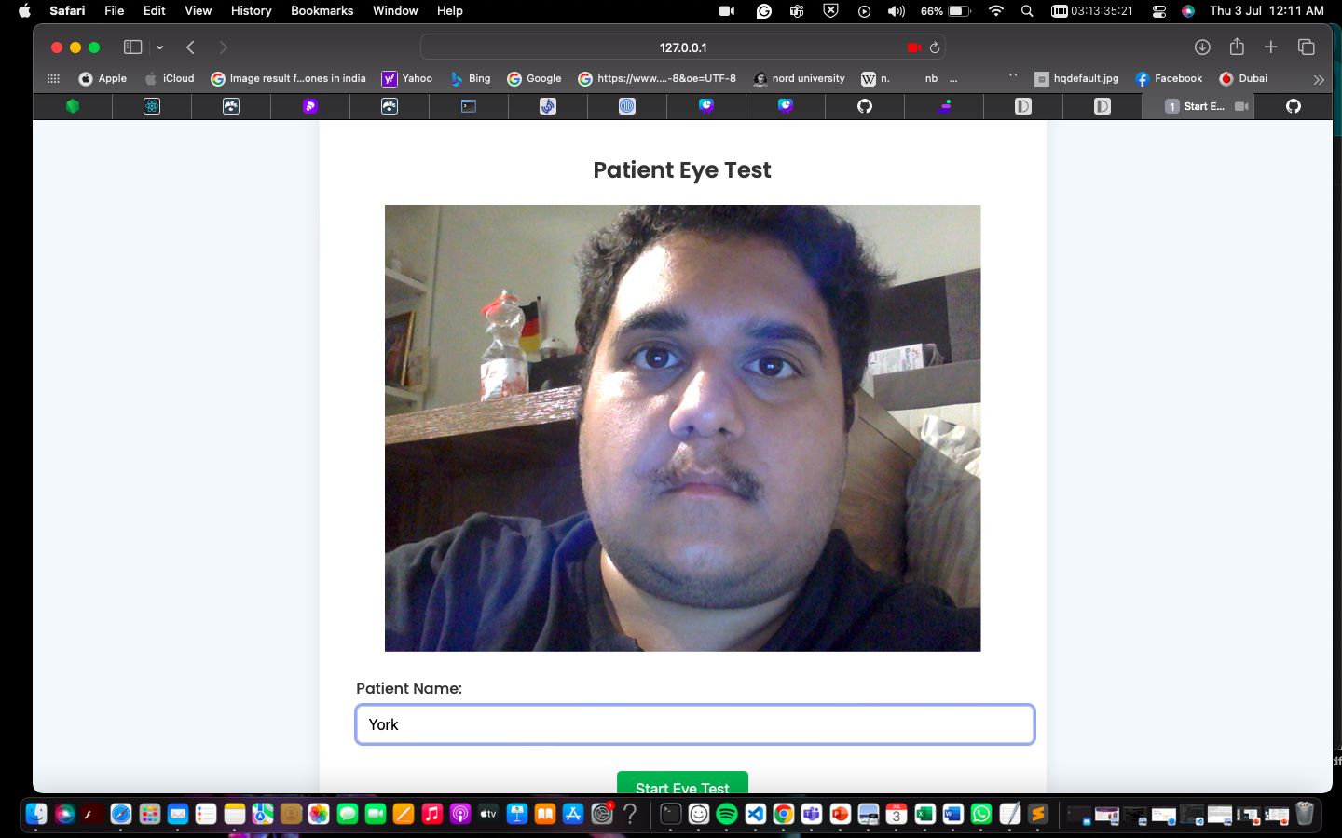
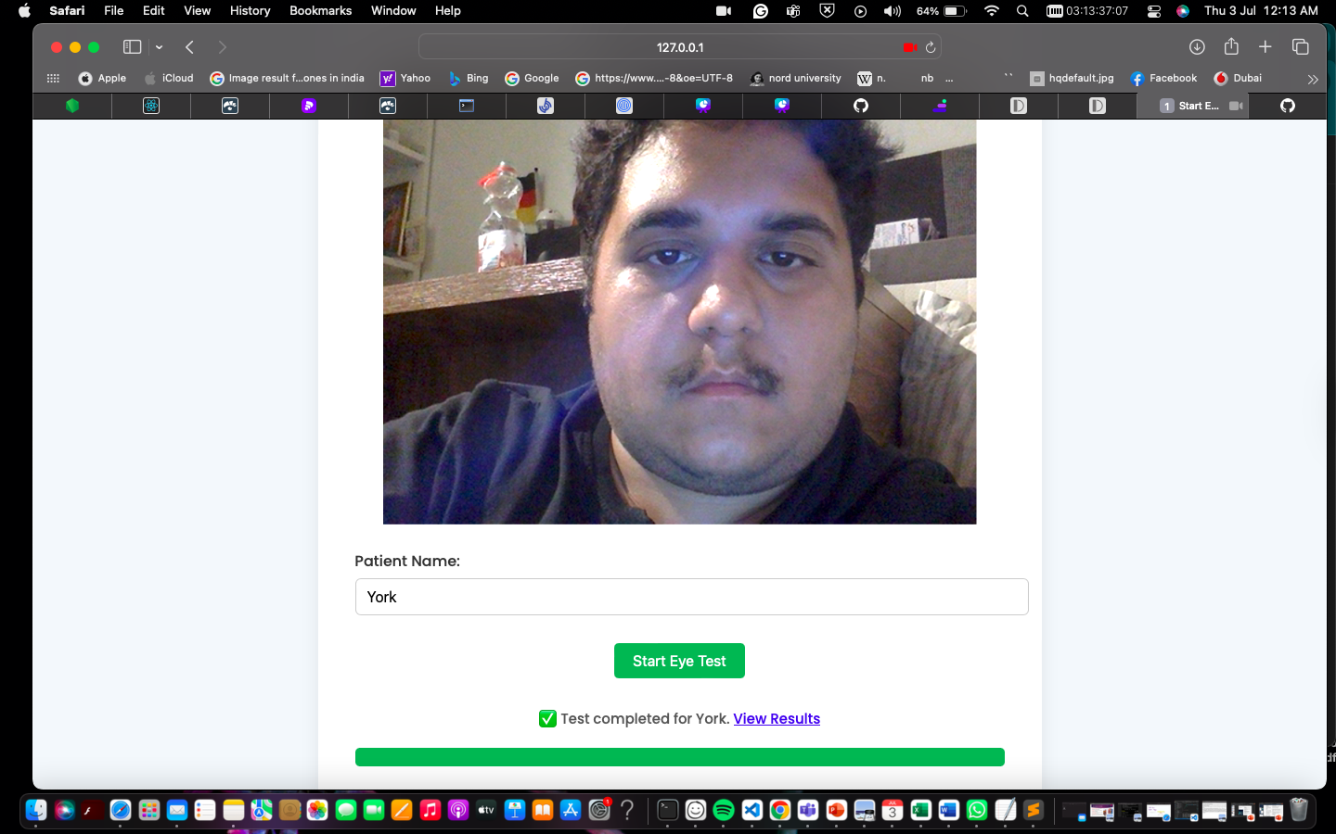
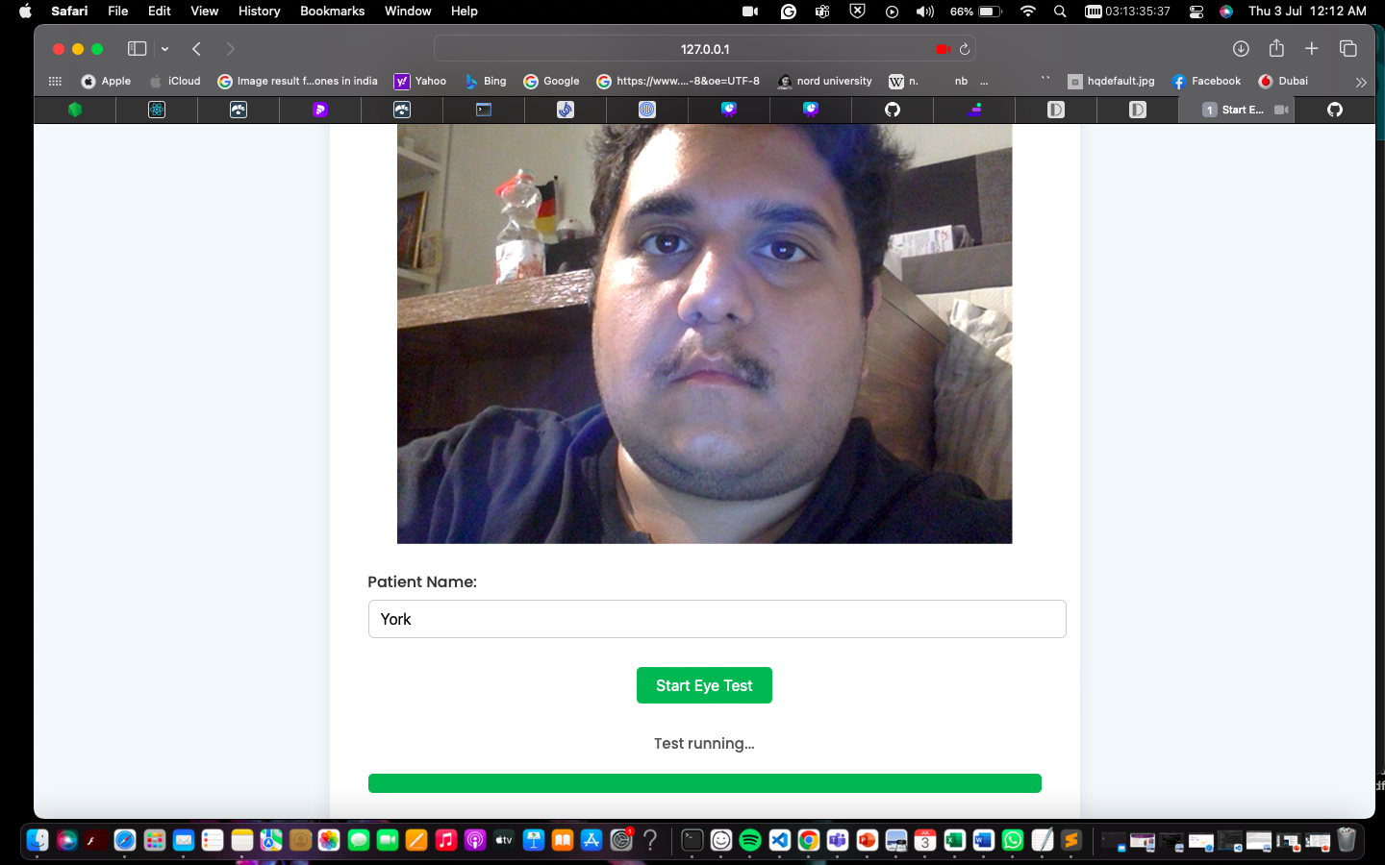
THE TEST PAGE - VIEW
FIGURE: SCREENSHOTS OF TEST PAGE
↘
The clinician, after clicking on the begin test button, reaches the test page where they can add a new patient name, and then the test begins. It takes at least 2 minutes for the test to finish patient ideally should be stable and under proper lighting for better results
←

Slide 12
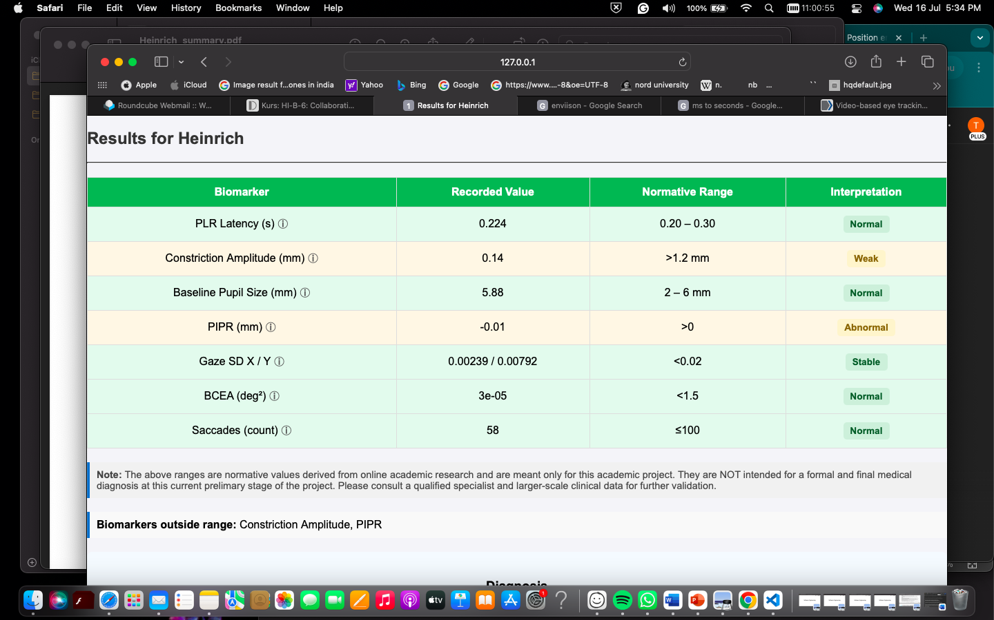
THE RESULTS PAGE - VIEW
FIGURE: SCREENSHOTS OF RESULTS PAGE
The results table displays key pupillary and gaze biomarkers with values, normative ranges, and color-coded interpretations. Tooltips explain each term, aiding quick understanding of clinical relevance and deviations.

Slide 13
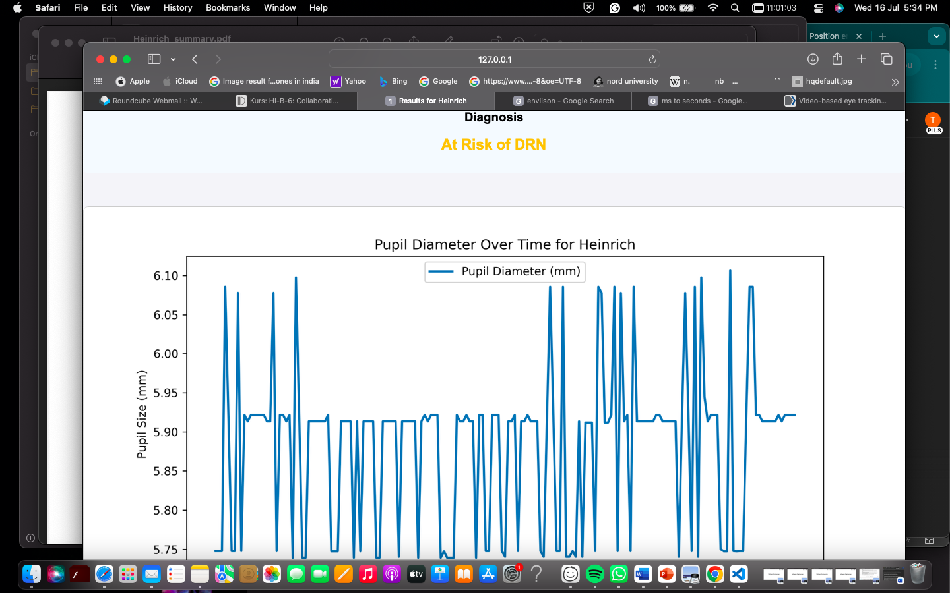
THE RESULTS PAGE - VIEW
FIGURE: SCREENSHOTS OF RESULTS PAGE
The two graphs represent:
Pupil Diameter Over Time – shows how the pupil size changes in response to light stimulus, indicating reflex strength and latency.

Slide 14
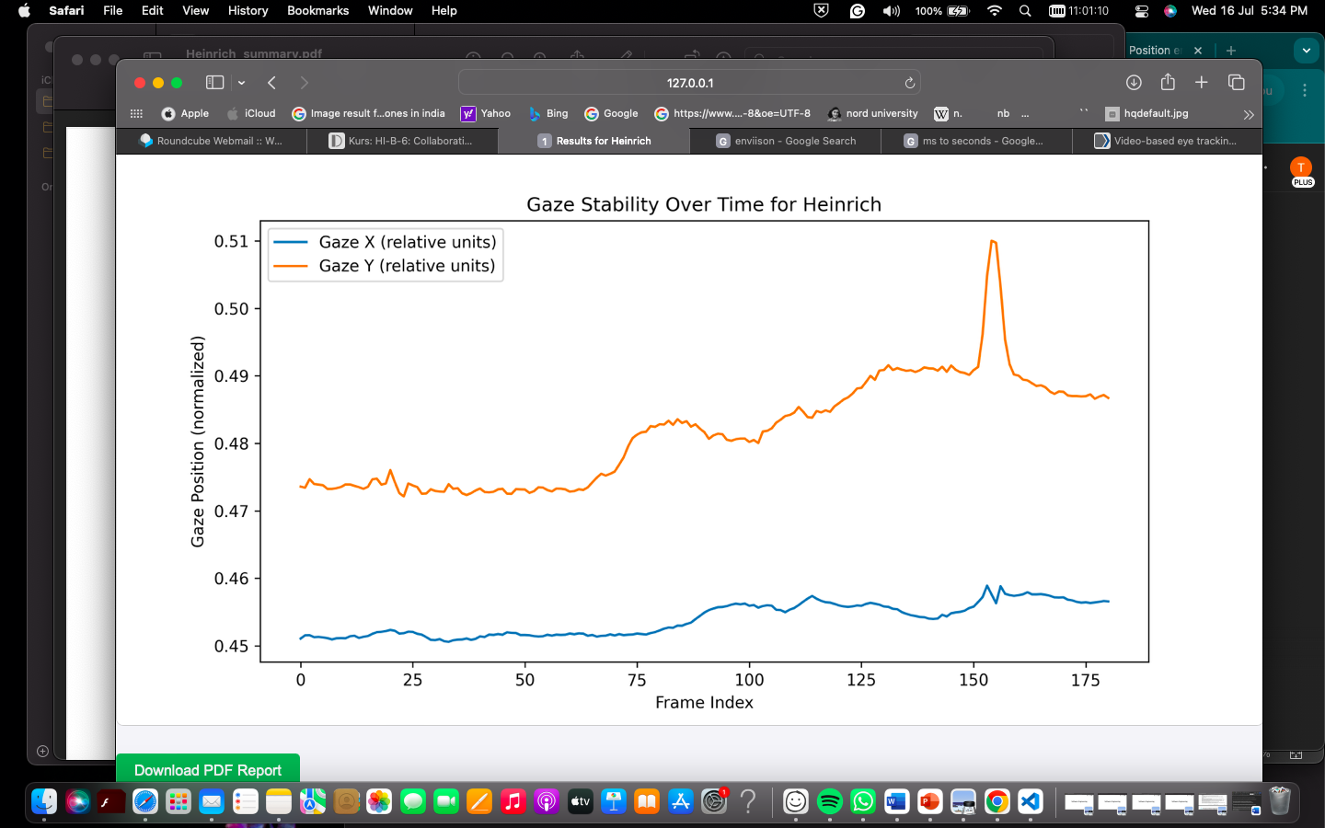
THE RESULTS PAGE - VIEW
FIGURE: SCREENSHOTS OF RESULTS PAGE
2. Gaze Stability Over Time – tracks eye movement to assess focus steadiness and possible neurological irregularities.
There is a download pdf button below.

Slide 15
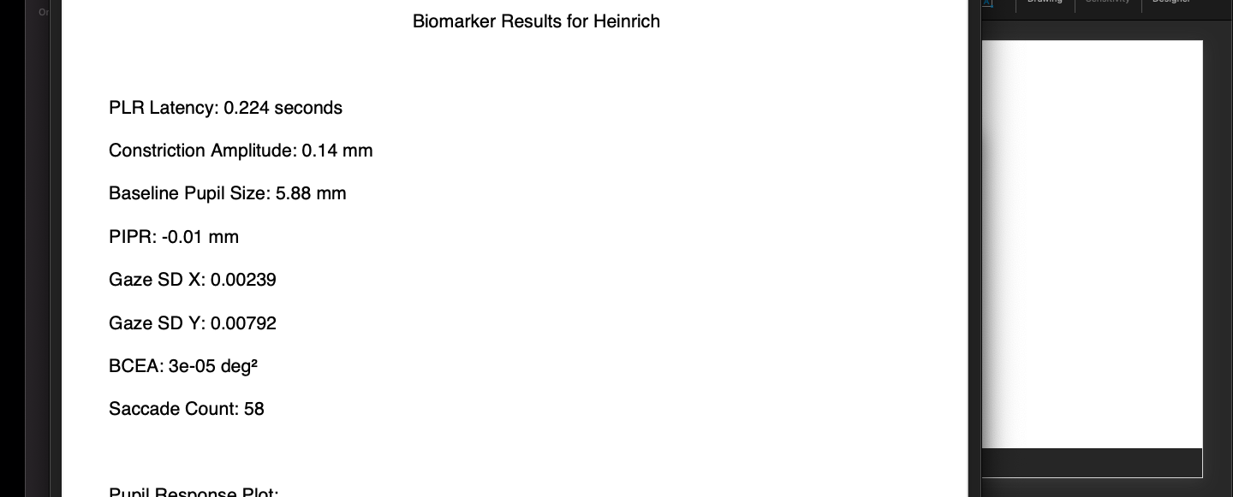
THE PDF PAGE - VIEW
FIGURE: SCREENSHOT OF PDF SUMMARY FOR A TEST PATIENT
The Download PDF button lets clinicians save a summary report containing all biomarker results, interpretations, and visual plots of pupil response and gaze stability for offline review or sharing.

Slide 16
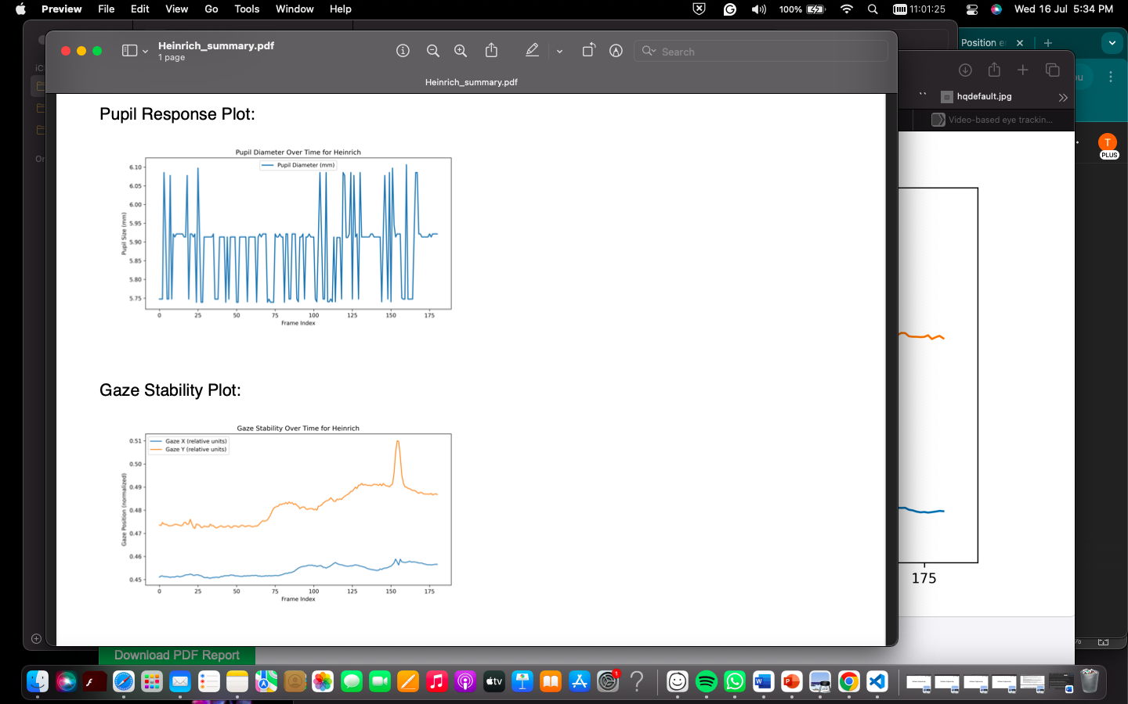
THE PDF PAGE - VIEW
FIGURE: SCREENSHOT OF PDF SUMMARY FOR A TEST PATIENT

Slide 17
THANK YOU!

